Slide 1
Pregnancy and Your Oral Health
insert presenter information
Notes:
Notes are included under each slide with presentation dialog

Slide 2
When should I see the dentist?
You could hurt yourself or your baby by NOT going to the dentist
Go any time for:
  Check-ups and cleanings
  Emergency care (including x-rays)
Second trimester or first half of third is best for procedures that require:
  Anesthesia
  Medication
  Time in the chair
Notes:
A recent study showed that only about one third of pregnant women visit the dentist while they are pregnant. Worse yet, only half of the women in the study who reported having a dental problem went to get care.
There is no evidence that routine dental examinations or treatment should not be performed during an uncomplicated pregnancy. In fact, not going to the dentist may cause problems such as oral infections that can cause the need for emergency care or affect the fetus.
You should make sure you have regular check-ups and cleanings any time during pregnancy to keep your mouth as healthy as possible.
Emergency dental treatment to relieve pain, swelling, bleeding or infection should be sought as soon as possible, no matter what stage of pregnancy. With today’s technology there is little radiation exposure to the fetus during dental x-rays when both a lead apron and a thyroid shield are used, so don’t worry if they are needed for emergency care.
Many women experience morning sickness during the first trimester, and may not be able to tolerate any procedures or instruments in their mouth. The first trimester is when the baby’s organs are developing, so it is best to avoid medication at this time if possible. The third trimester is also difficult for tolerating dental procedures, since lying back in the dental chair tends to be uncomfortable for the mother. Lying on your back for extended periods can reduce circulation to the fetus by placing pressure on the vein that returns blood from the lower part of the body to the heart.
It is probably best to schedule any necessary procedures that are longer than 45 minutes such as multiple fillings or crowns during the second trimester or early in the third trimester.

Slide 3
Safe Dental Treatment
Most treatments considered safe
Acceptable drugs
  Dental anesthetics
  Chlorhexidine rinse
  Fluoride treatment
  Tylenol
Give dentist your obstetrician’s contact information
Avoid
  Aspirin or ibuprofen
  Tetracyclines, chloramphenicol
Notes:
Overall, the majority of drugs commonly used in dentistry are considered safe to use during pregnancy. Commonly used antibiotics considered safe are penicillin, amoxicillin, cephalexins, erythromycins
Pain and fever relief is important during pregnancy. Untreated fever can cause problems with the baby’s development, especially during the first trimester. Severe pain can cause intense stress, leading to high levels of stress hormones and increased blood pressure, neither of which are good for your baby. Acetaminophen (Tylenol) is usually recommended for pain. Your dentist will probably want to contact your obstetrician if it is necessary to give you a stronger pain medication that contains narcotics, or a different antibiotic so make sure you bring the information on how to contact the physician who is providing your prenatal care with you to the dentist.
Aspirin or nonsteroidal anti-inflammatory drugs like Motrin or Advil can cause bleeding problems and other problems, and should be avoided.
You should never take any drugs that are in the tetracycline family, as they can cause damage to the baby’s developing teeth.

Slide 4
Fetal Growth and Development
Development of the mouth (prior to birth):
  4-5 weeks – primary (baby) tooth buds
  4-7 weeks – lips
  8-12 weeks – roof of mouth
  12 weeks – primary teeth start to harden
  6 months - permanent tooth buds
Notes:
The primary teeth begin to form around the 4th week in utero with mineralization (hardening) beginning around the 4th month of fetal development.

Slide 5
Orofacial Clefts – Cleft Lip and Palate
Cleft lip can form by the 8th week
Cleft palate can form by the 12th week
Usually accompanied by misshapen or missing teeth
Difficulty nursing/eating
Requires multiple corrective surgeries
Increases risk of ear infections
Causes:
  Family history (genetic)
  Diabetes
  Smoking tobacco
  Certain medicines to treat epilepsy, such as topiramate or valproic acid
Notes:
Cleft lip can form by the 8th week, and cleft palate by the 12th week, especially in mothers who have a genetic predisposition for orofacial clefting. This is very important, because babies with cleft lip, and especially cleft palate, have a difficult time eating. These defects are usually accompanied by funny-shaped or missing teeth if they involve the gum area. These defects usually require multiple corrective surgeries throughout childhood. Infants with cleft palate can get fluid in the middle ear, which can cause infections and hearing loss.
http://www.cdc.gov/ncbddd/birthdefects/cleftlip.html

Slide 6
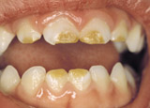
Childhood Enamel Hypoplasia
What is it?
  Deformed, weak enamel
  Disruptions of tooth development
  Teeth can decay more easily
Causes in utero:
  Fever in the pregnant mother
  Premature birth
  Low vitamin D levels
Causes early in life:
  Low birth weight
  Fever in infancy
Diann Bomkamp, RDH, BSDH, Missouri
Notes:
Enamel Hypoplasia is caused when something disrupts the cells that are forming the teeth. The affected area can be deformed or weakened or even missing altogether. These areas of the teeth can develop cavities very easily. It can happen due to illness or problems that occur during pregnancy or early in an infant’s life.
Common causes are untreated fevers or premature birth/ low birth weight.
New research has found that low vitamin D levels during pregnancy can also prevent proper tooth calcification, leading to enamel defects in baby teeth.

Slide 7
Who Wants a $1,000,000 $mile?
When is it safe to go to the dentist during pregnancy?
When you need a check-up or a cleaning
Only during the second trimester
When something hurts
A and C
Notes:
This game is a good way to get the group involved in your presentation.
Divide the group into two teams. Each team is to come up with an answer for each question presented. Keep score of the correct answers for each team.
The correct answer here is D. The second trimester is the easiest time to tolerate a dental procedure, but you can go to the dentist any time for an exam, a cleaning or a dental emergency procedure such as a root canal.

Slide 8
Changes During Pregnancy that Alter Oral Health
Hormonal Alterations:
  Increased tooth mobility
  Saliva changes – less protective
  Increased bacteria
  Gum problems
Notes:
Hormone changes, mainly estrogen and progesterone, can cause many changes in the mouth
The same hormones that increase ligament laxity in other joints during pregnancy can also cause increased mobility of the teeth. Severe mobility, however, may be a sign of severe periodontal disease and should be evaluated by a dentist as soon as possible.
Hormonal changes can also cause changes in saliva flow, either increasing or decreasing it. Changes in the quantity and quality can also occur, making it less protective.
Some types of bacteria that normally live in the mouth increase in numbers during pregnancy. These bacteria can cause tooth decay or gum disease.

Slide 9
Saliva changes
Decreased buffers
Decreased minerals
Decreasing flow first and last trimester
Increased flow second trimester
More acidic
Notes:
One of the body’s primary defenses against tooth decay is saliva. Saliva contains proteins and electrolytes that buffer and neutralize bacterial acids. It also contains the minerals calcium and phosphorus, which help to remineralize (harden) teeth.
During pregnancy, saliva composition may show a decrease in buffering ability and calcium levels.
During pregnancy, saliva may develop a lower pH or become more acidic. This change has been shown to be associated with increased levels of decay-causing bacteria.
Decreased saliva flow can cause dry mouth or Xerostomia. Some women experience the opposite problem of excessive salivation, or Pryalism.
Any of these changes in saliva may increase a woman’s susceptibility to tooth decay, so maintaining good oral hygiene habits becomes particularly important.

Slide 10
Increased Bacteria
Increased acidity
  Increase in decay-causing bacteria
Increased Snacking
  Morning sickness/low blood sugar
  Between-meal snacks
Increase in amount and frequency of starches/carbohydrates
  Crackers are commonly recommended
  Promotes decay-causing bacteria
Notes:
Many women experience nausea or hypoglycemia during pregnancy, which necessitates the consumption of between-meal snacks. Commonly promoted foods such as crackers may be high in starches (fermentable carbohydrates) that promote tooth decay. This increased frequency of food consumption and increase in carbohydrate intake can promote tooth decay by increasing the acid production of decay-causing bacteria.

Slide 11
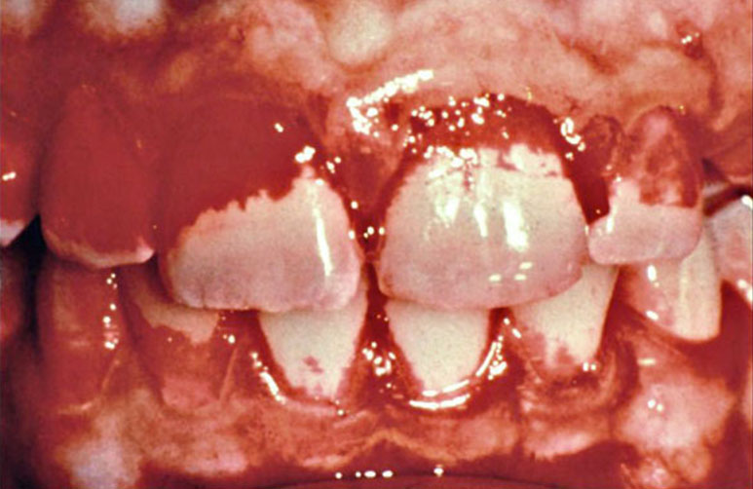
Disclosed Plaque
Courtesy Proctor & Gamble
Notes:
You have probably seen dental commercials that mention plaque. Plaque is a sticky, white, almost invisible film which slowly but steadily forms on your teeth 24 hours a day. It is mostly made up of bacteria. Bacteria are so small that they are normally invisible, but when they multiply and you have thousands of them stacked up on top of each other, you no longer need a microscope to see them.
If you scrape your teeth with your fingernail when you first wake up in the morning, you will see these bacteria as plaque – a white, pasty, cheese-whiz type of coating.
This picture shows someone who has rinsed with a special red dye that only sticks to bacteria. You can now see where the plaque is on the teeth.

Slide 12
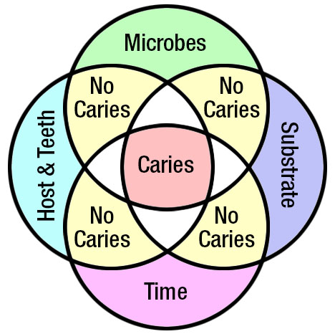
Increased Bacteria - Dental Decay
Courtesy Diann Bomkamp, RDH, BSDH, Missouri
Notes:
Four factors must be present for tooth decay to occur:
A tooth that is not well protected by saliva or fluoride
Acid-producing “bugs” (shown on the figure as “microbes” - S. mutans, Lactobacilli)
Sugary and starchy foods (fermentable carbohydrates) in the mouth (shown in the figure as “substrate”)
Repeated exposure to starches (shown in the figure as “Time”)

Slide 13

Diet and Dental Caries
Regular Meals (M)
Regular Meals (M)
plus
Sweet Snacks (S)
Plaque Acid Levels
Courtesy Proctor & Gamble
Notes:
This shows what happens when the previous factors (the tooth, the bacteria, the food) come together over time.
The carbohydrate (starch or sugar) in foods are turned into acids by bacteria in the mouth, shown as the orange peaks over time.
Acids attack the teeth for approximately 20 minutes after a meal. Each exposure can damage the teeth.
The more often we eat foods with carbohydrates, the more “acid attacks” our teeth are exposed to, and the more likely we are to develop a cavity.

Slide 14
Who Wants a $1,000,000 $mile?
What is a cavity?
A large hole in the head
A disease
A hole in the tooth
Both B and C
Notes:
The correct answer is D. Tooth decay is an infectious disease that is caused by bacteria in the mouth. As it progresses, it causes a hole in the tooth.

Slide 15
Increased Oral Bacteria During Pregnancy
Increased food supply – frequent meals/snacks
Increased hormones
  Gingival fluid and saliva contain hormones
  Cause gums to swell, bleed easily, and secrete more fluid
  Bacteria use hormones for energy to grow and multiply
Decreased immune response limits mouth’s ability to fight bacteria
Notes:
Eating small frequent meals, as recommended during pregnancy, can cause an increase in bacteria growth, because they have a nearly continuous food supply.
Gingival fluid is the fluid that is normally produced by the gums in the crevice between the gums and teeth. This fluid contains antibodies and normally has a slightly protective effect. However, in pregnancy, this fluid contains high levels of hormones. Some types of bacteria can use these hormones for energy, and they can grow and multiply and cause problems with the gums.
Saliva also contains higher levels of hormone that can trigger bacteria growth.

Slide 16
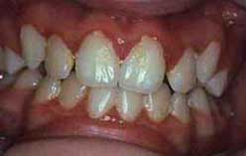
Gum Problems
Pregnancy Gingivitis
  Red edges
  Swollen or puffy
  Tender
  Bleed easily during brushing
Courtesy of Phoenix College
Notes:
This is a view of the minor gum changes that can occur, often referred to as pregnancy gingivitis. This condition is easily reversible with increased hygiene and a cleaning.
Pregnancy gingivitis can progress to gum disease if it is not treated. Pregnancy hormones, particularly progesterone, can cause loss of the bone that supports the teeth if gum disease is present. It is very important to see your dentist to prevent gum disease and bone loss.

Slide 17
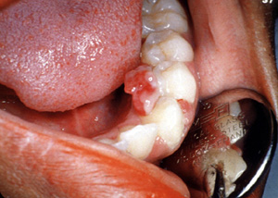
Gum Problems - Pregnancy Granuloma
Courtesy of Univ. of Southern California
Notes:
In about 5 to 10% of women, the increased response of the gums in the presence of pregnancy hormones can cause irritated gum tissue to grow into a lumpy mass known as a pregnancy granuloma (often misnamed a Pregnancy “Tumor”). These usually start growing during the second trimester and are usually found between the teeth. They bleed easily and have a red, raw-looking rumpled surface. If they are small and do not cause any problems, your dentist will probably advise you to wait and see if they go away after the baby is born. If they do not go away after delivery, they can be removed surgically.

Slide 18
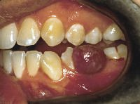
Gum Problems - Pregnancy Granuloma
Courtesy of Univ. of Southern California
Notes:
When a pregnancy granuloma becomes too large, it can get in the way of chewing. They can even cause too much bleeding and become painful.
If this happens, your dentist will probably want to remove it right away and clean the teeth around the area thoroughly.

Slide 19
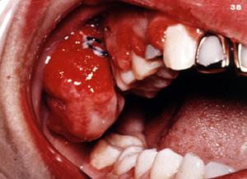
Gum Changes - Pregnancy Granuloma
Courtesy of Univ. of Southern California
Notes:
This pregnant woman has a very large granuloma, and severe irritation of the gums surrounding the other teeth as well. This lesion will probably have to be removed so the mother can eat and clean her teeth properly.

Slide 20
Who Wants a $1,000,000 $mile?
Some signs of gum disease are…
Red, scaly patches
Black, hairy patches
Bleeding, swelling or tenderness
None of the above
Notes:
The correct answer is C. Bleeding, swelling or tenderness are all signs of gum disease. Keep in mind, though, that some women do not notice any signs until the disease becomes severe. The only way to know for sure whether you have gum disease is to visit your dentist for an examination.

Slide 21
Changes During Pregnancy that Affect Oral Health
Morning sickness
  Difficulty with hygiene
    Gum disease
    Tooth decay
  Vomiting
Esophogeal Reflux (heartburn)
Acid exposure
  Irritation of the gums
  Weakening of tooth enamel
  Dental erosion
Notes:
Morning sickness can cause problems with oral health if the nausea makes it difficult for the pregnant woman to use a toothbrush or floss. Some women are so sensitive that they have a difficult time tolerating anything placed in the mouth.
If this causes a disruption of normal hygiene such as brushing or flossing, the bacteria that are normally present in the mouth are likely to cause pregnancy gingivitis or tooth decay.
The nausea that is often experienced during the first trimester is sometimes accompanied by vomiting. During the third trimester some women also develop severe heartburn or esophogeal reflux which propels stomach acid up into the mouth. Stomach acids irritate the gingival tissue. Stomach acids also soften the outer layers of tooth enamel allowing it to be removed easily. If this happens repeatedly the enamel will become thinned. This process is called dental erosion.

Slide 22
Treatment for Acid Exposure
Do NOT brush immediately after vomiting
Rinse
  Water with baking soda
  Antacid
  Plain water
Eat some cheese
Ask about fluoride rinse or gel
Notes:
Tooth brushing should never be performed immediately after the mouth is exposed to stomach acid. The brushing action can remove the softened outer layer of enamel, causing it to thin.
Rinsing with a solution of water that contains baking soda will neutralize the acid and allow the saliva to remineralize the tooth. If baking soda is not available, liquid antacids or plain water may be used.
Studies have shown that eating a small piece of cheese will quickly neutralize acids in the mouth and boost calcium levels, helping to protect the teeth from damage.
If acid exposure happens repeatedly on a daily basis, tell your dentist. You may need a fluoride mouth rinse or prescription fluoride gel to prevent dental erosion.

Slide 23
Oral Diseases Can Effect Pregnancy
Periodontal (gum) disease linked to:
  Pre-eclampsia
  Preterm birth
  Low birth weight
Dental cleaning to remove calculus (tartar) is safe for pregnant women and can treat gum disease.
Notes:
Many studies have shown that women who have a preterm delivery are more likely to have had gum disease during pregnancy. This makes sense because gum disease is a bacterial infection. It has long been known that infections in other areas of the body can cause preterm labor and delivery. Disease-causing bacteria produce toxins that pass into the bloodstream and cause the body to produce chemicals to try to fight off the disease process. These chemicals are the same ones that can induce contractions.
Ide M, Papapanou PN. J Periodontol. 2013 Apr;84(4 Suppl):S181-94. Epidemiology of association between maternal periodontal disease and adverse pregnancy outcomes - systematic review.
Takeuchi N, Ekuni D, Irie K, Furuta M, Tomofuji T, Morita M, Watanabe T. Arch Gynecol Obstet. 2013 May;287(5):951-7. Relationship between periodontal inflammation and fetal growth in pregnant women: a cross-sectional study.

Slide 24
Prevention: Oral Hygiene
Reduce the amount of bacteria in your mouth.
  Brush at least twice a day with fluoride toothpaste
  Floss once a day
  Antibacterial mouth rinses
  Xylitol gum or mints after snacks (sugary drinks count as a snack!)
Keep routine dental visits!
  TRICARE Dental Program pays for 3 checkup/cleaning visits during pregnancy
Notes:
It is very important to maintain good oral hygiene practices to prevent both dental decay and gum disease.
Dental floss prevents both dental decay on contact surfaces and gum disease. Ideally, flossing should be performed once per day, before brushing. Brushing should be performed at least twice daily with fluoridated toothpaste. Fluoride remineralizes (hardens) any areas of the tooth enamel that have been weakened by bacterial acids. There is no need to rinse the mouth after brushing. In fact, NOT rinsing allows the fluoride to remain in contact with the tooth surfaces, where it is most effective.
American Dental Association approved antibacterial mouth rinses are very helpful for fighting gingivitis. If you have gum disease, your dentist may want to prescribe a stronger mouth rinse that has chlorhexidine in it.
Xylitol is a natural sweetener that is found in fruits and vegetables such as plums, strawberries and raspberries. It is usually made from certain hardwoods such as the birch tree.
Xylitol:
• Blocks bacteria from producing the acids that cause tooth decay
• Decreases the levels of cavity-causing bacteria
• Decreases plaque formation by bacteria on the teeth
• Enhances remineralization (hardening) of weakened tooth structure
• Must be chewed for only 5-10 minutes after meals and snacks (4-5 times a day) for best effect.
Keeping your regular dental exam schedule allows your dentist to detect and treat any problems that may develop during your pregnancy.

Slide 25
Prevention: Nutrition for Oral Health
Eat well-balanced meals
  B vitamins, especially folate (folic acid)
  Vitamin C
  Vitamin D
  Calcium
  Protein
  Fiber
Snack smart
  Avoid starchy or sugary snacks and drinks
  Raw fruits and vegetables
  Dairy products
Notes:
B vitamins are important for maintaining the health of oral tissues such as the lining of the mouth and tongue. One B vitamin, Folic acid, appears to be important in the prevention of cleft lip and palate in the developing baby. Cleft lip can form by the 8th week, and cleft palate by the 12th week. The majority of studies have shown that an adequate intake of folate (folic acid) reduces the chances of having clefting problems, even in mothers who have a genetic predisposition for orofacial clefting.
Fiber, Protein and Vitamin C are important for healthy saliva that can protect teeth from decay.
It also helps maintain healthy gums during pregnancy.
Vitamin D and Calcium are important for both the health of the mother’s bones and teeth and the proper development of the baby’s bones and teeth.
Substituting fruits and vegetables for starchy, high carbohydrate snacks will decrease your chances of tooth decay and increase your intake of vitamins and minerals.

Slide 26
Who Wants a $1,000,000 $mile?
Oral diseases can be prevented by…
Using fluoride rinse
Brushing with fluoride toothpaste 2-3 times a day
Eating nutritious foods
A and B
All of the above
Notes:
The correct answer is E. Oral diseases during pregnancy can be prevented by brushing 2-3 times daily with fluoridated toothpaste, and eating nutritious foods that provide vitamins and are low in sugar. If you have problems with vomiting or acid reflux, you would probably also benefit from using a fluoride rinse.

Slide 27
Acknowledgements
COL Georgia Rogers
Consultant to the Army Surgeon General for Dental Public Health
Additional graphics or information provided by the following:
  Diann Bomkamp, RDH, BSDH, Missouri
  WI Dept. of Health and Family Services
  University of Southern California
  Phoenix College
  Proctor & Gamble
  Dr. Luke Shwart, Calgary Health Region

